Slide 1
User Study Presentation
EWOR: Education Platform Design
Group 9
21.11.2019
Notes:
Alright, welcome to our presentation of the results of our user study. With this study we wanted to figure three things out: How our users interact with our landing page and how we can improve things there, which type of interest check they prefer and if they need additional features (for example a communication tool).

Slide 2
Content
Methodology
Tested Products & Results
Landing Page
Interest Check
Communication Tool
Notes:
So this is a quick rundown of everything we’re gonna talk about in the next five minutes - So we’ll quickly go over the different methodologies used in this user study, and then we’ll show you everything that we’ve tested (so Landing Page, Interest Check and the Communication Tool) and the results we’ve had.

Slide 3
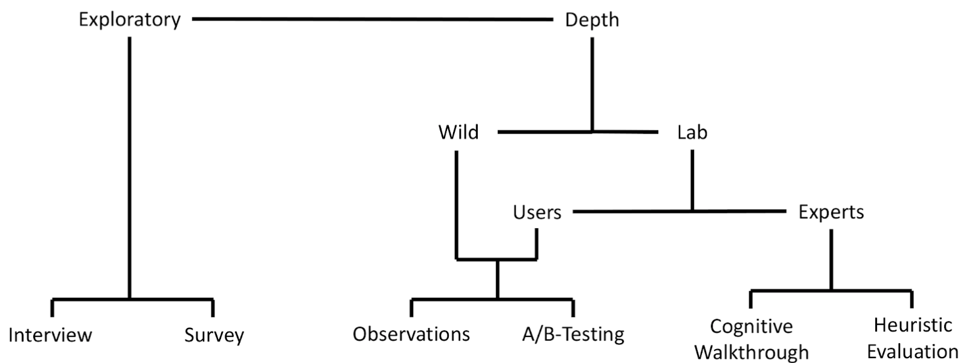
Applied Methods
Landing Page
Communication Tool
Landing Page
Interest
Check
Notes:
Alright - which methods did we use? Obviously, different methods are better suited for different products. So for the Landing Page (CLICK), we used a combination of observations and interviews and a survey, (CLICK) we used A/B testing for the interest check and we’ve used (CLICK) a survey for the communication tool.
All of this was done with 9 participants.

Slide 4
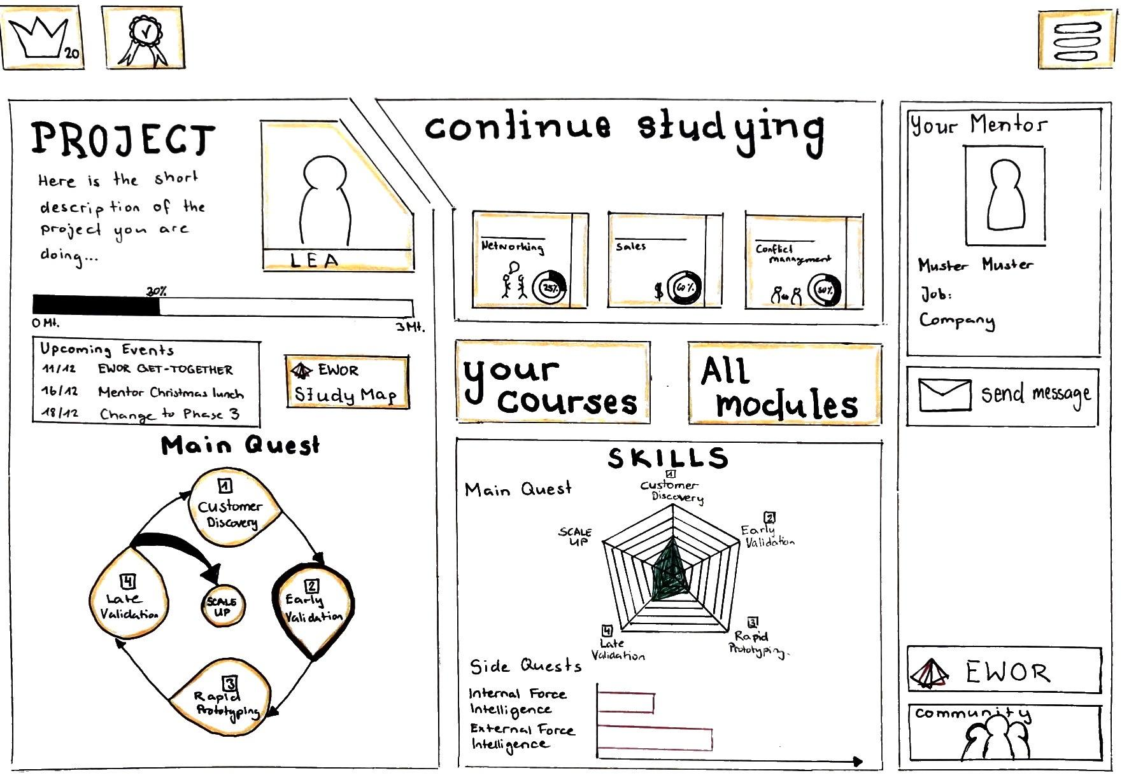
Landing Page: Overview
Notes:
So let’s start off with the landing page. This is what the paper prototype looks like - and thanks to our own wizard of oz, it is fully functional. Our participants then had to do a series of ten tasks, where we recorded the amount of time and clicks they needed as well as our own other observations. After that, they filled out a survey.

Slide 5
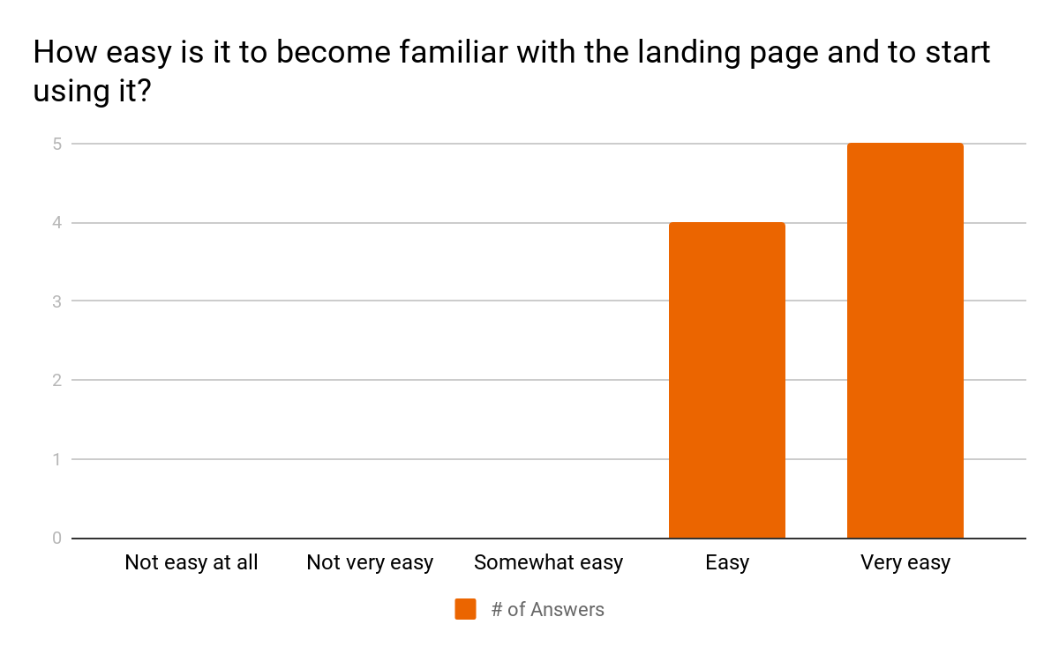
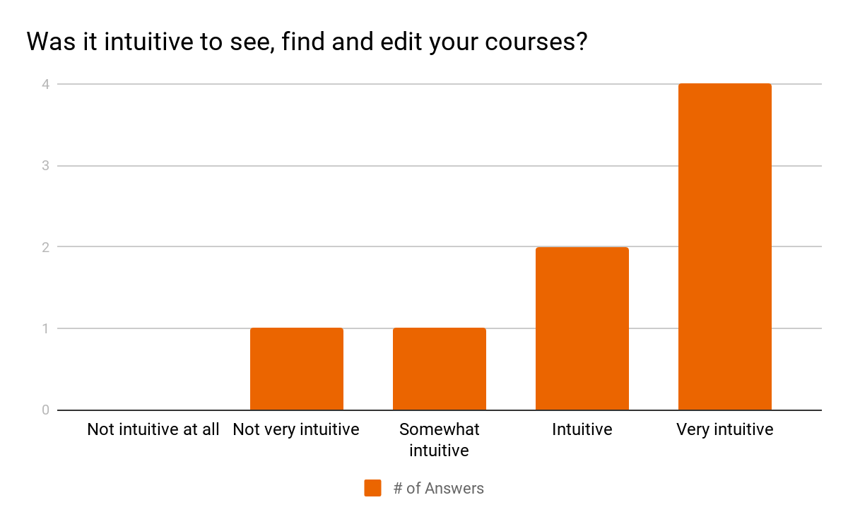
Landing Page: Survey Results
Notes:
These are some of the results from the survey. As you can see, all of our participants found it easy to get the hang of our landing page, and while some still had their difficulties managing their courses, generally, also this interface seems good.

Slide 6
Landing Page: Survey Results
Unclear Things:
Progress presentation, the spider diagram and its relevance
Terminology:
“Main” and “Side Quests”
“Quest” vs. “Module” vs. “Course”
Notes:
In the survey, They also had the opportunity to give direct feedback about things they found unclear. And almost every one of them had something to say about this skill progress spider diagram. For one, apparently it is not very obvious what this thing even means, and that the terminology used is also not very clear.

Slide 7
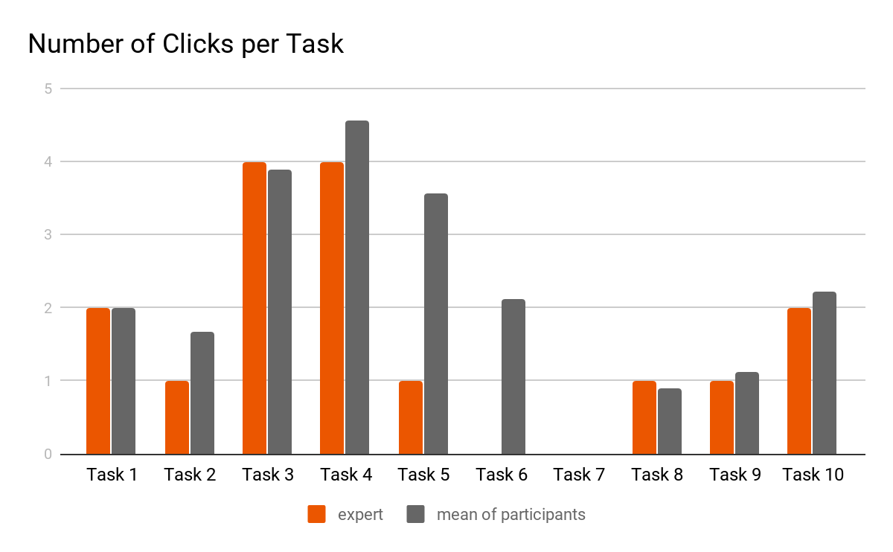
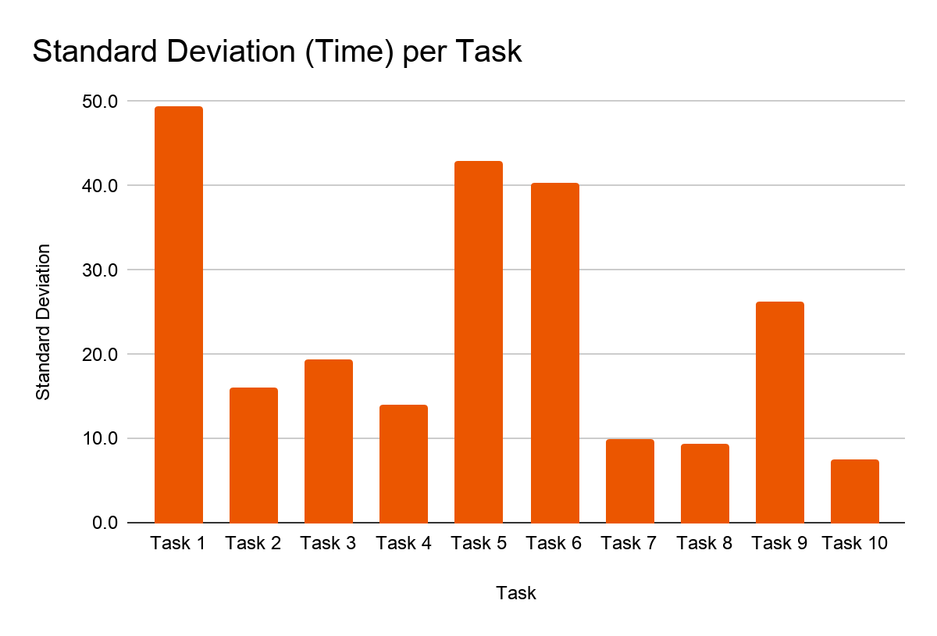
Landing Page: Observations & Timing Data
Task 5: You are in Phase 2 of the project and want to know what courses belong to it. Figure it out.
Task 6: In which phase of the main quest did you complete the most modules?
Notes:
Lastly, we also did our own observations while our participants completed their tasks. So to figure out which tasks were more difficult than they have to be, we measured two things - the average number of clicks our participants needed, and the variance they had in solving them. If we have a look at the left diagram, you can see for example that tasks 5 and 6 have a big difference between the minimum amount of clicks required and the average our participants had - and you can see this also from the standard deviation graph on the right. These results also tie in very nicely with the survey answers.
The high standard deviation for task 1 can be explained with the short task time, and task 9 was one where an oral answer was required, so that naturally varies a lot.
Now, philipp is gonna tell you about the interest check and communication tool.

Slide 8
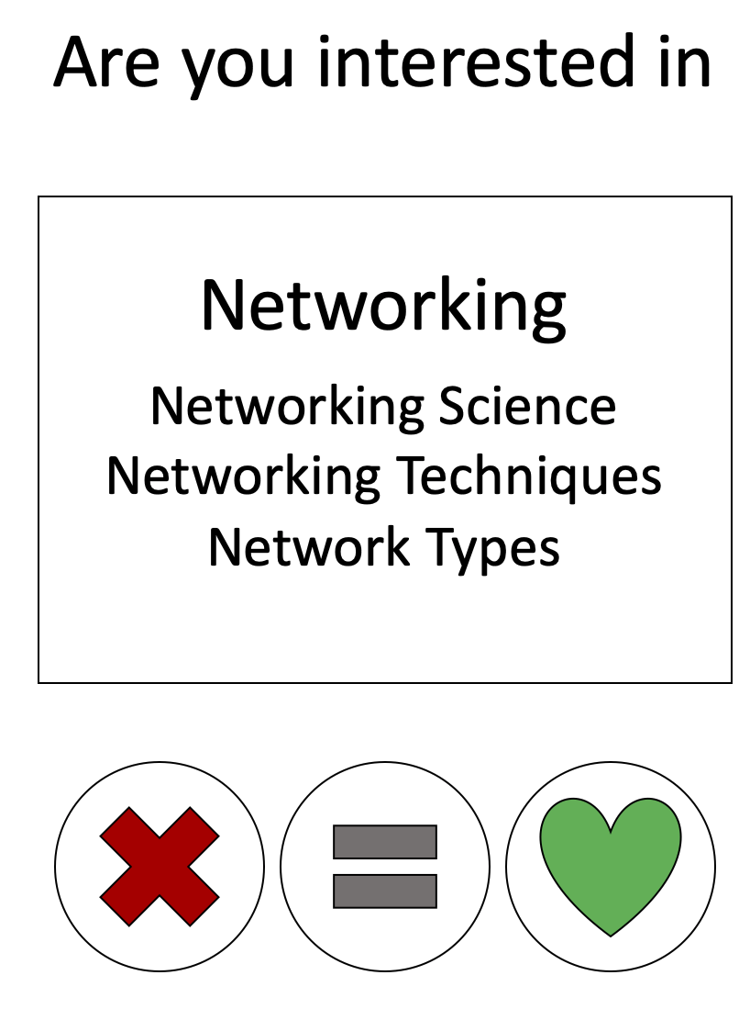
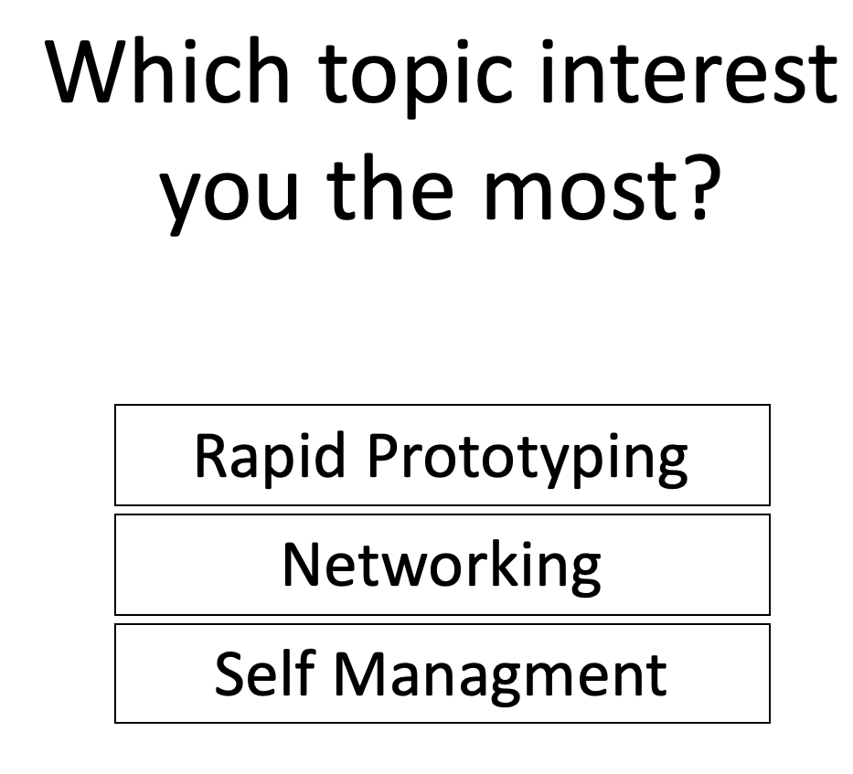
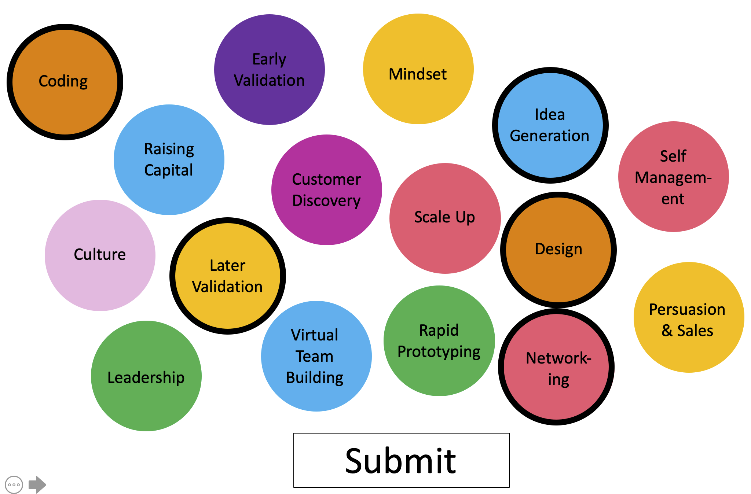
Interest Check
Like/Dislike
Comparison
Bubbles
Notes:
Protoype Like/Dislike -> with closer descriptions of the topics
Prototype Comparision -> would lead to ranked interests
Prototype Bubbles -> full overview off all topics, a little bit like Netflix

Slide 9
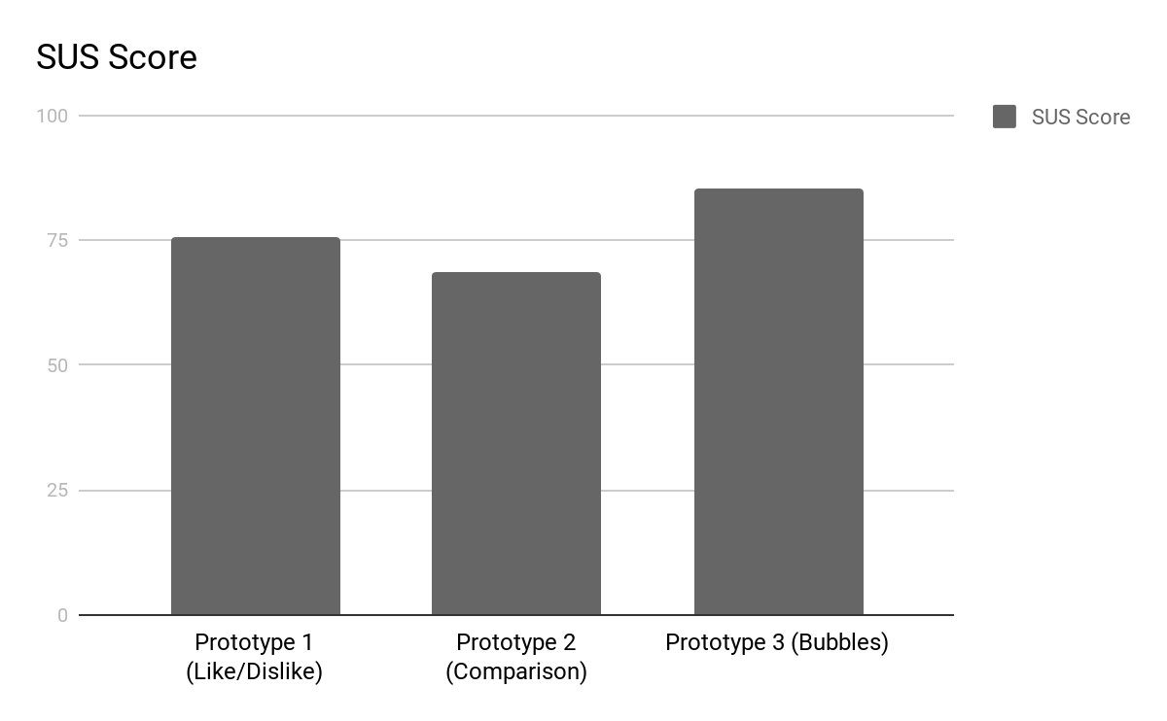
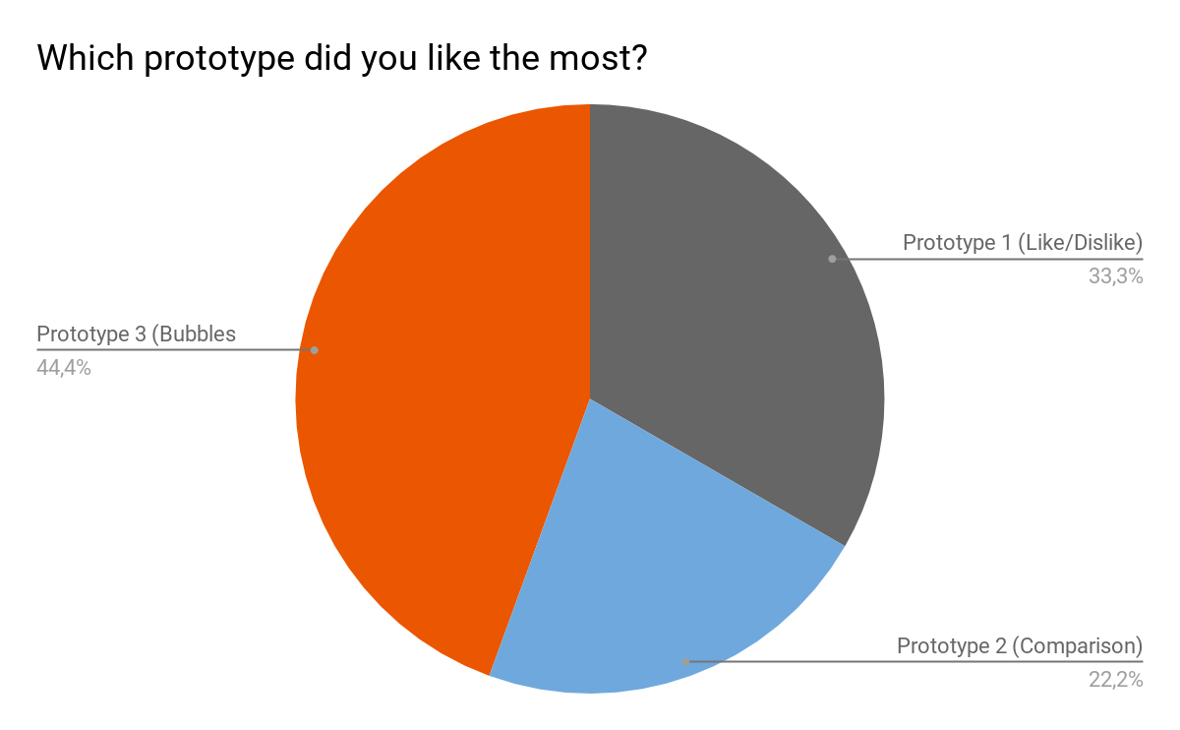
Interest Check Results
Notes:
System usability scale (SUS)
Prototype 1 76
Prototype 2 69
Prototype 3 85
Reference line at 68 stand for good usability
-> Prototype 3 was the most liked by the participants

Slide 10
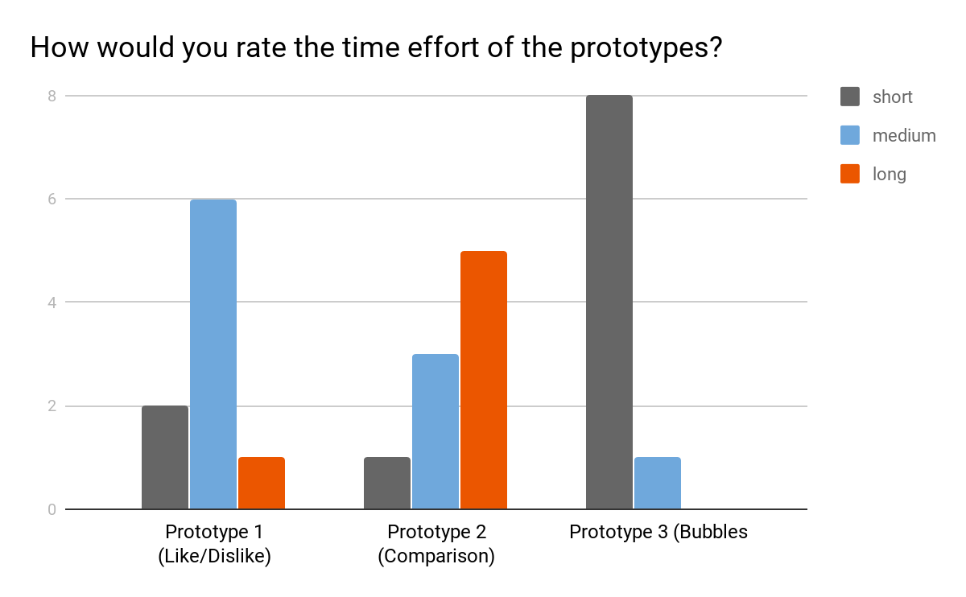
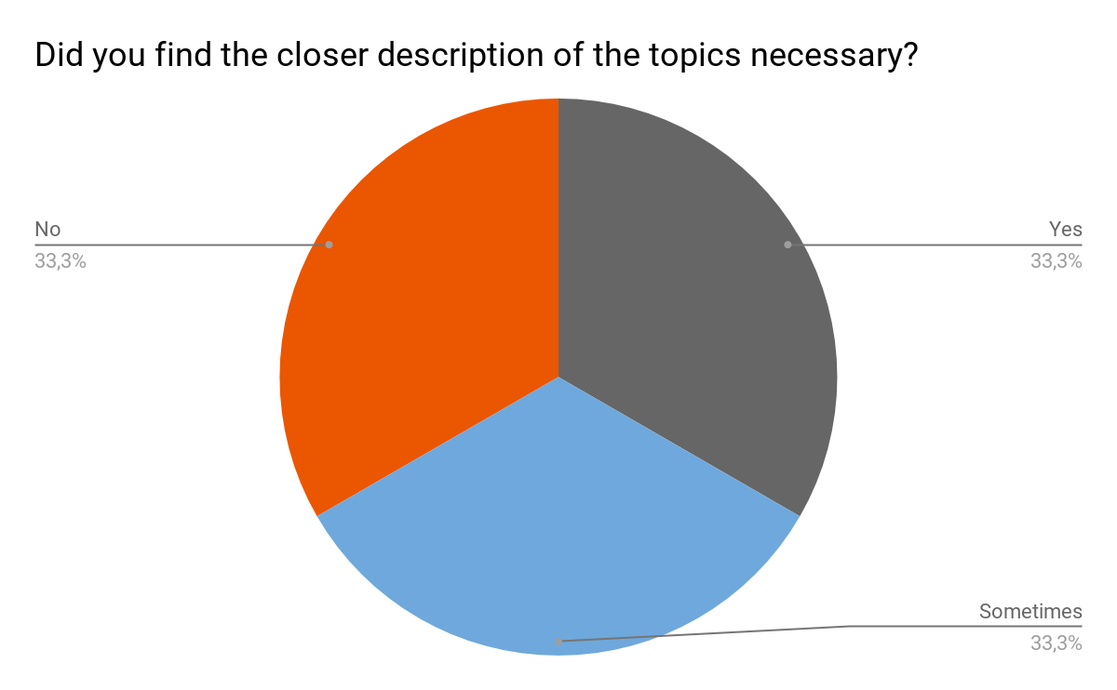
Interest Check Results
Notes:
Task should be repetitive -> time is a metric for prototype evaluation
Prototype 3 34 s & short
Prototype 1 95 s & medium
Prototype 2 61 s & long -> more cumbersome than Prototype 1
⅓ does not find topic descriptions necessary, but ⅔ would like them -> discuss classification and granularity of topic description with stakeholder

Slide 11
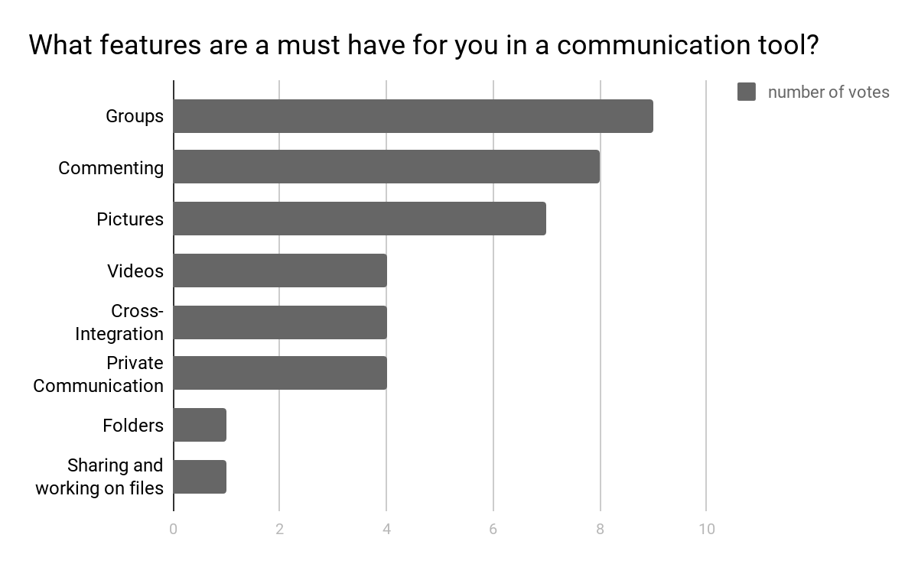
Communication Tool Results
Notes:
In the second stakeholder meeting they told us to focus more on a peer to peer interaction also for the communication tool
Only one had not used a communication tool in a project
But 66 % did not use it (because self organized communication like wa, mails)
Communication to mentor and other participants is desirable
To keep the communication tool simple, asked which feature are necessary
Group and commenting
Basis for a more specific ideation process and foundation for first low file prototypes

Slide 12
Questions?

